Slide 1


Accounting RATIOS

Slide 2
RATIOS - INTRODUCTION
A ratio is a mathematical number calculated as a reference
to relationship of two or more numbers and can be
expressed as a fraction, proportion, percentage, and
a number of times.
Accounting ratio may be expressed as an arithmatical
relationship between two accounting variables.
The technique of accounting ratios is used for analysing
the information contained in financial statements for
assessing the solvency, efficiency and profitability of
the firms.

Slide 3
OBJECTIVES OF RATIO ANALYSIS
To simplify the accounting information
To determine the liquidity( short term and long
term financial obligations)
To assess the operational efficiency of the
business
To analyse the profitability of the business
To help in comparative analysis ( inter firm and
intra firm comparisons)

Slide 4
ADVANTAGES OF RATIO ANALYSIS
Useful tool for analysis of financial statements
Simplifies accounting data
Useful for forecasting
Useful in inter firm and intra firm comparison
Useful in locating the weak areas.
Useful in assessing the operational efficiency of
business

Slide 5
LIMITATIONS OF RATIO ANALYSIS
It can give false result
Qualitative factors are ignored
Lack of standard ratio
May not be comparable
Price level changes are not considered
Leads to window dressing
Leads to personal bias

Slide 6
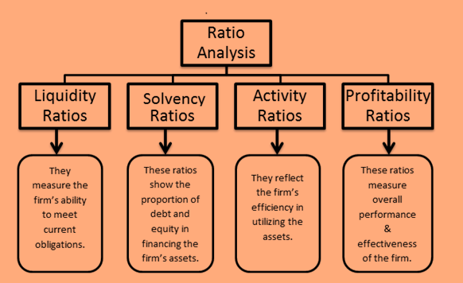
Pure
Pure
Times
Percentage

Slide 7
1.LIQUIDITY RATIOS
CURRENT RATIO
LIQUID RATIO
Liquid or Quick Assets
Current liabilities
Current assets
Current liabilities
QUICK ASSETS = CURRENT ASSETS – INVENTORY –
PREPAID EXPENSES

Slide 8
Current ratio/ Working capital ratio :
This ratio establishes the relationship between current assets and current liabilities and is used to assess the short term financial position of the business concern. Ideal ratio is 2:1.
Current Assets : Current Liabilities
Significance- A very high current ratio implies heavy investment in current assets which is not a good sign as it reflects under utilisation or improper utilisation of resources. A lowratio endangers the business and puts it at risk of facing a situation where itwill not be able to pay its short-term debt on time.
INCLUDED IN CURRENT ASSETS
Current investments
Inventories
(excluding loosetools, stores & spares)
c . Trade receivables
(B /R and Drs less provision)
d. Cash &cash equivalents
(cash in hand, cash at bank, cheques/drafts)
e. Short term loans and advances
f. Other current assets
(prepaid expenses, interest receivable, accured income)
INCLUDED IN CURRENT LIABILITIES
a. Short term borrowings (bank overdraft)
b. Trade payables
(B/P & Crs)
c. Other current liabilities (outstanding expenses, calls in advance, received in advance)
d. Short term provisions

Slide 9
LIQUID RATIO/QUICK RATIO/ACID TEST RATIO
This ratio establishes relationship between liquid assets and currentliabilities and is used to measure the firm’s ability to pay the claims of creditors immediately. Ideal ratio is 1:1
Quick ratio = Quick Assets : Current Liabilities
While calculating quick assets we exclude the closing stock and prepaid expenses from the current assets .
Significance :
A low ratio will be very risky and a high ratio suggests unnecessarily deployment of resources in otherwise less profitable short-term investments.
Current assets = Total assets – fixed assets – non current investment
Current liabilities = Total debts – long term debts
Liquid assets = Current assets – inventory-prepaid expenses
Working capital = Current assets – current liabilities
Current liabilities = Trade payables + other current liabilities
Current liabilities = Total assets – capital employed
Current assets = Capital employed + current liabilities – fixed assets

Slide 10

SOLVENCY RATIOS
Solvency ratios are calculated to determine the ability of the business to service its debt. In other words it shows the firms ability to meet its long term obligations. They are expressed in pure form.
The Solvency ratios are :
1. Debt-Equity Ratio
2. Proprietary Ratio
3. Total Assets to Debt Ratio
4. Interest Coverage Ratio
Solvency ratios
Debt-Equity Ratio
Total Assets to Debt Ratio
Interest Coverage Ratio
Proprietary Ratio

Slide 11
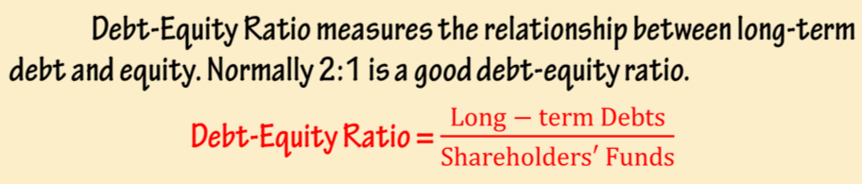
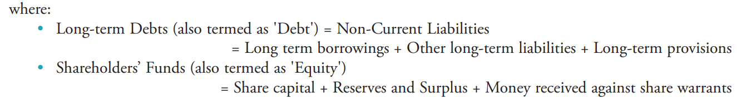
1. Debt-Equity Ratio

Slide 12
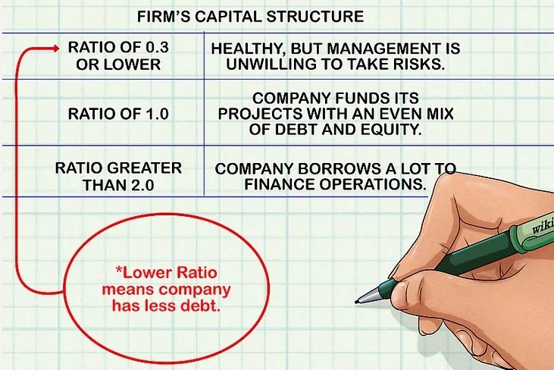
SIGNIFICANCE
The objective of debt to equity ratio is to measure the proportions of external funds and shareholders funds invested in the company.
A high debt to equity means that the firm is depending more on borrowings as to shareholders funds. So lenders are at higher risks and have lower safety.
A low ratio means that the firm is depending more on shareholders funds than borrowings. So lenders are at a lower risk and have higher safety. A low ratio reflects more security.
So it is considered to be safe if debt equity ratio is 2:1.

Slide 13
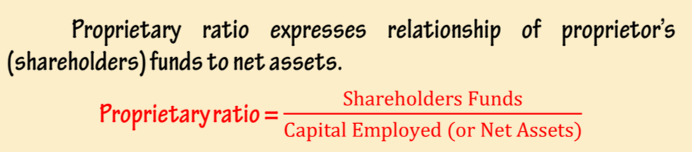
2. Proprietary Ratio
Proprietory Ratio may be expressed either as ‘pure’ or ‘percentage’
Capital employed = Total Assets – Current Liabilities

Slide 14
FORMULAES TO CALCULATE SHARE HOLDER FUND
LIABILITIES APPROACH: Share capital + Reserves & Surplus
II) ASSETS APPROACH :
Non current assets + Working capital ( CA –CL) – Non current liabilities
Non current assets = Tangible fixed assets + Intangible assets + Non current investments + Long term loans & advances
Current assets = Current investments + Inventories +Trade receivables + Cash & cash equivalents + Short term loans & advances + Other current assets
Current liabilities = Short term borrowings + Trade payables + Other current liabilities + Short term provisions
Non current liabilities = Long term borrowing s + Long term provisions

Slide 15
SIGNIFICANCE
The objective of this ratio is to measure the proportion of total assets financed by proprietors funds.
A high ratio means adequate safety for unsecured lenders and creditors
It also means improper mix of proprietors funds and loan funds, which results in low return on investment.
A low ratio indicates greater risk to unsecured lenders and creditors and the firm getting benefit of trading on equity.

Slide 16
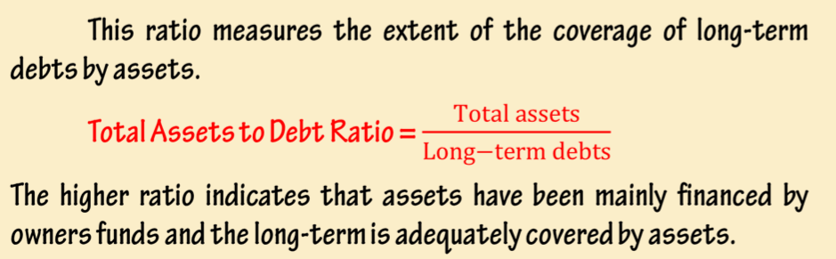
3. Total Assets to Debt Ratio
This ratio is expressed in ‘pure’ form

Slide 17
FORMULAES :
TOTAL ASSETS INCLUDE :
* Non current assets = Fixed ( tangible + intangible) + Non current investments + Long term loans & advances
* Current assets = Current investments + inventories ( including loose tools & spare parts) + Trade receivables + Cash & cash equivalents + Short term loans & advances + Other current assets
DEBT INCLUDE:
* Long term borrowings
* Long term provisions

Slide 18
SIGNIFICANCE
The objective of this ratio is to establish relationship between
total assets and long term debts of the firm. It measures the
‘safety margin’ available to the lenders of the long term debts.
It measures the extent to which debt is covered by the assets of the firm.
A high ratio means higher safety to lenders
A low ratio means lower safety for lenders as the business depends largely on the outside loans.ie, investment by the proprietor is low.

Slide 19
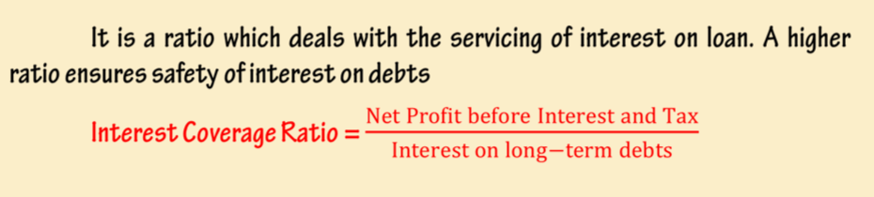
4. Interest Coverage Ratio
This ratio is expressed in times

Slide 20
SIGNIFICANCE
This ratio is very useful to debenture holders and lenders of
long term funds.
The objective of this ratio is to ascertain the amount of profits
available to cover interest on long term debt.
A high ratio is better for the lenders as it as shows higher
margin to meet interest cost.

Slide 21

ACTIVITY (OR TURNOVER) RATIO
These ratios indicate the speed at which, activities of the business are being performed. So they are also called as “Performance ratios.”These ratios measure the effectiveness with which the enterprise uses its available resources. These ratios are expressed in times. The activity ratios are ;
1. Inventory Turnover
2. Trade Receivables Turnover
3. Trade Payables Turnover
4. Working Capital Turnover.
ACTIVITY (OR TURNOVER) RATIO
Inventory Turnover
Trade Receivables Turnover
Trade Payables Turnover
Working Capital Turnover.

Slide 22
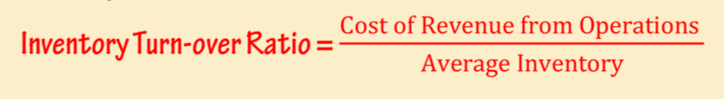
1. Inventory Turn-over Ratio
Significance :
The objective of this ratio is to ascertain whether investment in stock
has been judicious or not. It shows the number of times amount
invested in inventory is rotated.
A high ratio shows that more sales are being produced by a rupee of
investment in inventories. It shows overtrading and may result in
working capital shortage.
A low ratio means inefficient use of investment in inventories, over
investment in inventory, accumulation of inventory etc.

Slide 23
FORMULAES :
i) Cost of revenue from operations :
= Revenue from operations – Gross profit
(Or)
Revenue from operations + gross loss
(Or)
Opening inventory + net purchases + direct expenses – closing inventory
ii) Average inventory :
= opening inventory + closing inventory
--------------------------------------------------------
2
NOTE: IF TIMES WORD IS GIVEN THEN WE MULTPLY AND IF MORE WORD IS GIVEN THEN WE ADD IN INVENTORY AS PER THE QUESTION

Slide 24
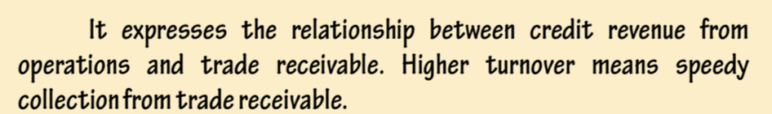
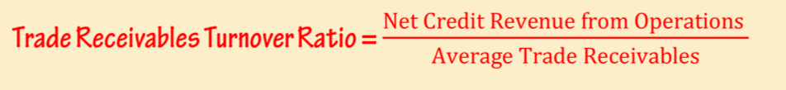
2. Trade Receivables Turnover Ratio
Significance :
This ratio indicates the number of times trade receivables are turned
over in a year in relation to credit sales. It shows how quickly trade
receivables are converted into cash and the efficiency in collection of
amounts due against trade receivables.
A high ratio is better since it shows that debts are collected more
promptly.
A lower ratio shows inefficiency in collection or increased period
and more investment in debtors than required.

Slide 25
FORMULAES :
i) CREDIT REVENUE FROM OPERATIOINS :
= CREDIT SALES – SALES RETURN
(OR)
REVENUE FROM OPEATIONS –CASH REVENUE FROM OPERATIONS
ii) AVERAGE TRADE RECEIVABLES :
OPENING DRS + b/R + CLOSING DRS+ B/R
-------------------------------------------------------------
2
iii) DEBT COLLECTION PERIOD :
365
------------------------
TRADE RECEIVABLES TURNOVER RATIO
(OR)
12
--------------
TRADE RECEIVABLES TURNOVER RATIO

Slide 26
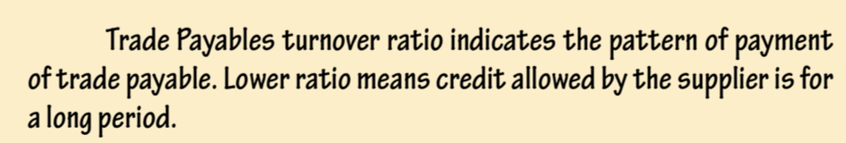

3.Trade Payables Turnover Ratio
Significance :
The objective of this ratio is to determine the efficiency with which
the trade payables are managed and paid.
A high ratio or shorter payment period shows the availability of less
credit period or early payments. It indicates that the firm is not
availing full credit period and this boosts up credit worthiness of the
firm.
A low ratio indicates that creditors are not paid in time or increased
credit period.

Slide 27
FORMULAES :
i) AVERAGE TRADE PAYABLES :
OPENING CRS + B/P + CLOSING CRS + B/P
------------------------------------------------------------
2
ii) AVERAGE PAYMENT PERIOD :
AVERAGE TRADE PAYABLES x No: Of months / days
Net credit purchases
(Or)
Months or days in a year
-----------------------------------------
Trade payables turnover ratio

Slide 28
4. Working capital Turnover Ratio
It shows the relationship between working capital and revenue from operations. It shows the no .of times a unit of rupee invested in working capital produces Sales.
Significance :
The objective of this ratio is to ascertain whether or not working capital has been effectively used in generating revenue
A high ratio shows efficient use of working capital. It indicates overtrading-working capital being inadequate for the scale of operations
A low ratio shows inefficient use of working capital.
Working Capital Turnover Ratio = Revenue from operations
Working capital
Note: working capital = current assets – current liabilities

Slide 29

PROFITABILITY RATIOS
Efficiency in business is measured by profitability. “Profitability” refers
to financial performance of the business. These ratios are expressed
in percentage. The profitability ratios are :
Gross profit Ratio
Operating Ratio
Operating profit Ratio
Net profit Ratio
Return on Investment Ratio
PROFITABILITY RATIOS
GROSS PROFIT
OPERATING
OPERATING PROFIT
NET PROFIT
RETURN ON INVESTMENT

Slide 30

1. Gross Profit Ratio
Gross profit Ratio establishes the relationship between
gross profit and revenue from operations. This ratio shows the profit margin on goods sold.
The main objective of computing this ratio is to determine the efficiency with which
production and purchase/sales operations are carried on.
Higher Gross Profit Ratio is better as it leaves higher margin to meet operating expenses and creation of reserves.

Slide 31

2. Operating Ratio
Operating ratio establishes the relationship between operating cost
( cost of revenue from operations + operating expenses) and revenue from
operations.
The objective of computing this ratio is to assess the operational efficiency
of the business.
Lower operating ratio is better because it leaves higher profit margin to meet non operating expenses, to pay dividend etc.
A rise in the operating ratio indicates decline in efficiency.

Slide 32
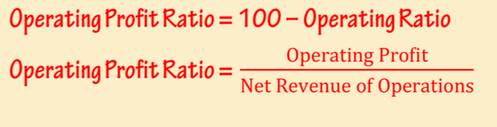
3. Operating Profit Ratio
Operating profit ratio measures the relationship between operating profit
and revenue from operations.
The objective of computing this ratio is to determine operational efficiency
of the business.
An increase in the ratio over the previous period shows improvement in the
Operational efficiency of the business enterprise.

Slide 33

4. Net Profit Ratio
Net profit ratio establishes the relationship between net profit and revenue from operations. It relates revenue from operations to net profit after operational as well as nonoperational expenses and incomes.
Net profit is an indicator of overall efficiency of the business. Higher the ratio, better the business. An increase in the ratio over the previous period shows improvement in the operational efficiency and decline means otherwise

Slide 34

5. Return on Capital Employed or Investment (ROCE or ROI)
ROI shows the relationship of profit (profit before interest and tax)with capital employed. This ratio assesses overall performance of the enterprise.
It measures how efficiently the resources of the business are used.
ROI is a fair measure of the profitability of any concern with the result that the performance of different industries may be compared.

Slide 35
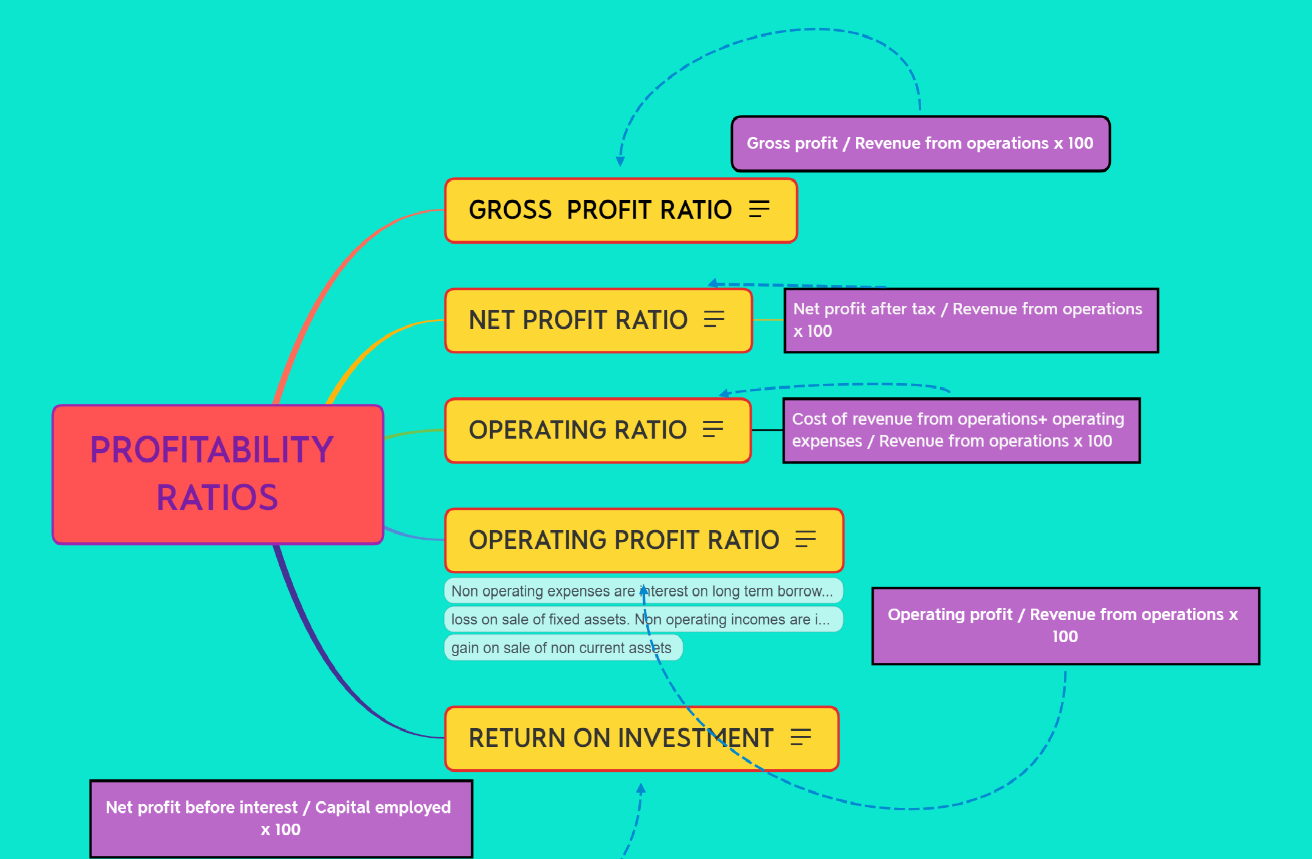

Slide 36

EFFECT OF RATIOS
UNDER VARIOUS CASES

Slide 37

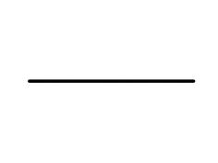


CASE 1
WHEN ONLY NUMERATOR INCREASES.
THE RATIO INCREASES.

Slide 38

CASE 2
WHEN ONLY NUMERATOR DECREASES.
THE RATIO DECREASES.

Slide 39
CASE 3
WHEN ONLY DENOMINATOR INCREASES.
THE RATIO DECREASES.

Slide 40

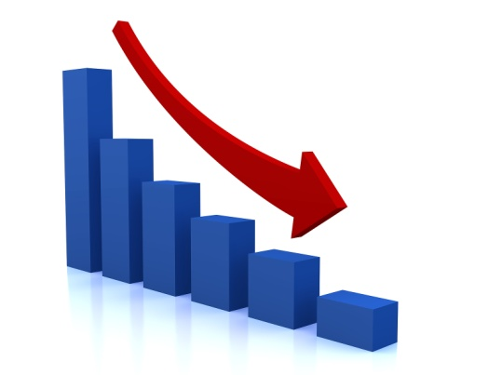
CASE 4
WHEN ONLY DENOMINATOR DECREASES.
THE RATIO INCREASES.

Slide 41
CASE 5
WHEN NUMERATOR
INCREASES WHILE
DENOMINATOR DECREASES
THE RATIO INCREASES.
N
D

Slide 42

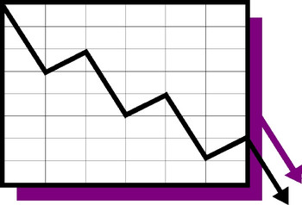

CASE 6
WHEN NUMERATOR
DECREASES WHILE
DENOMINATOR INCREASES
THE RATIO DECREASES.
N
D

Slide 43

CASE 7
a. If the original ratio is greater than 1, the ratio
WHEN BOTH NUMERATOR AND DENOMINATOR
INCREASE BY THE
SAME AMOUNT.
b. If the original ratio is
less than 1, the ratio
c. If the original ratio is
= 1

Slide 44
CASE 8
If the original ratio is
greater than 1, the ratio
WHEN BOTH NUMERATOR AND DENOMINATOR
DECREASE BY THE
SAME AMOUNT.
b. If the original ratio is
less than 1, the ratio
c. If the original ratio is
= 1

